Slide 1

Employer-led Hospital Price Transparency Study
Gloria Sachdev, Pharm.D.
President and CEO, Employers’ Forum of Indiana
Associate Professor, Purdue College of Pharmacy
Adjunct Assistant Professor, Indiana University School of Medicine
gloria@employersforumindiana.org
Rand 2.0 Authors:
Chapin White, Ph.D., Senior Policy Researcher, RAND Corp
Christopher Whaley, Ph.D., Policy Researcher, RAND Corp
National Alliance for Health Care Purchasers Coalition
July 9, 2019
Webinar for Coalition Employers
The contents represent the views of the authors and not the organization or it’s funders

Slide 2
About the Employers’ Forum of Indiana
Healthcare coalition formed in 2001
Members include self-funded employers, health plans, health systems, and other interested parties
Aim is to improve the value payers and patients receive for their health care expenditures
www.employersforumindiana.org

Slide 3
Members of the Employers’ Forum of Indiana
Anthem Blue Cross and Blue Shield
AON
American Health Network
Assured Partners
Barnes and Thornburg
Castlight Health
Chrysler (FCA)
Columbus Regional Hospital
Community Health Network
Cummins Inc.
Deaconess Hospital
Eli Lilly and Company
Encore Health
Eskenazi Health
Fort Wayne Community School Corp
Franciscan Alliance
Gregory & Appel
Healthcare Options
Indiana Farm Bureau
Indiana State Teachers Union
Indiana Health Information Exchange
Indiana Rural Health Association
Indiana University
Indiana University Health
Ivy Tech
JA Benefits
LHD Benefit Advisors
Mercer
Merck (affiliate)
Monarch Beverage
Northwest Radiology
OneAmerica
OneBridge
Ortho Indy
Our Health Inc.
Parkview Health
Purdue University
Roman Catholic Archdiocese of Indianapolis
Roche & Genentech
St. Vincent Health
State of Indiana
Suburban Health Organization
The Henriott Group
Tippecanoe School Corp.
TrueRx
United Healthcare
Young at Heart Pharmacy

Slide 4
“Twenty years of wage stagnation on the middle class has been 95% caused by exploding healthcare costs.” - WSJ
The Health Market Place:
Providing a Failing
Value-Proposition
Notes:
Functional markets result in a reciprocal
Both parties must find the relationship synergistic
If a market’s a loser for producers, they get out
If a market’s a loser for purchasers, they don’t buy
Except in HC: If you have breast cancer or your kid has leukemia
You can’t afford to opt out of the market
So you rob from Peter to pay Paul
In this case, Paul will drive you into bankruptcy

Slide 5
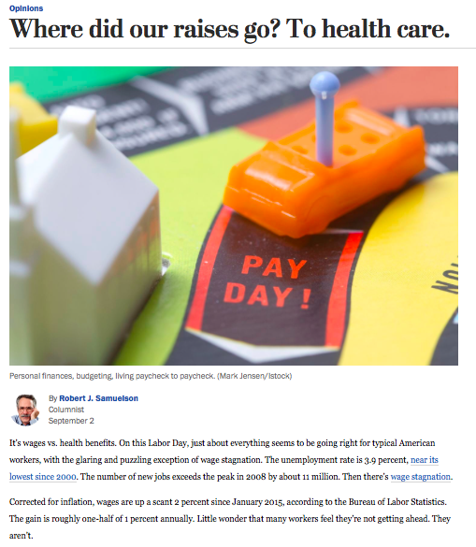

Edging Out Salary Growth & Economic Development
Notes:
For year’s now, coinsurance, copays, and deductibles have…
Offset wage increases for employees in the 6 bottom wage deciles
Teachers in Jeffco paying 23% of salary for coverage

Slide 6
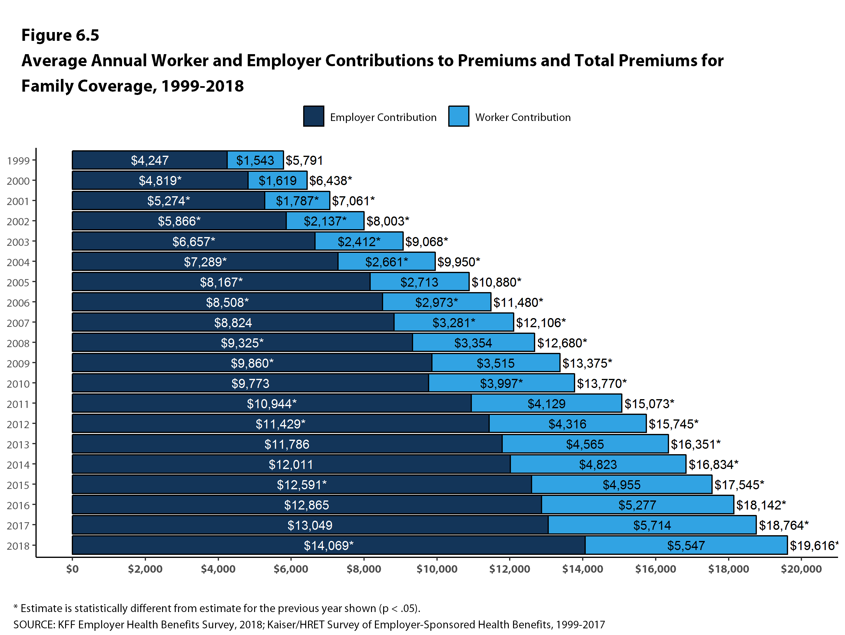
The Problem: Employer premiums have risen, and so have employee contributions.
*Estimate is statistically different from estimates for the previous year shown (p<.05).
SOURCE: KFF Employer Health Benefits Survey, 2018; Kaiser/HRET Survey of Employer-Sponsored Health Benefits. 1999-2017
Notes:
The Kaiser Family Foundation annual survey collected employer health plan information, including premiums paid by employees and the employer contribution. This shows a growing trend in the total family premium amounts both pay year over year.

Slide 7
Our Goal is to Improve Value, Where Value Includes Cost and Quality
BEST Value = High Quality
Cost
where Cost = Price + Quantity

Slide 8

QUESTIONS the Forum Aimed to Answer
Part A:
-Are hospital prices high in Indiana?
-How do prices compare among our hospitals?
-Where can we find good value?
-What is our trend?
Part B:
-How do our prices compare to those in other states?

Slide 9
Partnership between the Employers’ Forum of Indiana and RAND
FORUM’s Role:
commission and partner with RAND Corp to conduct Round 1.0, Round 2.0, and Round 3.0 analyses per MOU
RAND’s Role:
conduct all study analyses
prepare study final reports and supplemental material
co-develop study design
co-recruit nationally for study participation
co-develop study design
co-recruit nationally for study participation

Slide 10
Question-Part A: Are Hospital Prices High In Indiana?
Price Transparency Analysis
Aim:
To develop a fair method to compare hospital prices for public reporting
The best method the Forum believed was to convert allowable payments made by employers to what Medicare would have paid for the exact service, thus report relative prices
For Example: the report shows that employers paid Hospital “A” 200% or 2X on average what Medicare would have paid and Hospital “B” was paid 350% or 3.5X on average what Medicare would have paid

Slide 11
The Rationale For Using Medicare to Level Set All Commercial Hospital Payments
Medicare is the Largest Health Insurer in the World
Medicare makes numerous adjustments in price to assure FAIR payments are made to a hospital and their methods are published:
type & intensity of service/patient acuity
hospital’s location
disproportionate share of medically underserved
medical education provided

Slide 12
RAND Study 1.0 Study Findings
Indiana Commercial Hospital Allowable Prices Paid as a Percent of What Medicare Would Have Paid for the Same Services
272%
217%
358%
Source: White, 2017, Hospital Prices in Indiana.

Slide 13
RAND 1.0 Study Findings
Relative Prices are Trending Up Away From Medicare
Source: White, 2017, Hospital Prices in Indiana.

Slide 14
Part B: How Does Indiana Compare to other States: RAND 2.0 Study was Published on May 9, 2019
We have created a webpage that includes everything: RAND 2.0 National Hospital Price Transparency Report, Rand 2.0 Supplement Database, RAND 2.0 Interactive Map Tool, News, Sign up for RAND 3.0, FAQ for RAND 3.0 and more:
www.employerPTP.org
You may also find the full report and supplement database on the RAND website:
https://www.rand.org/pubs/research_reports/RR3033.html

Slide 15
Our Study Made National & Local News…over 30 News Outlets, including:
Many Hospitals Charge Double or Even Triple What Medicare Would Pay
The New York Times, May 9, 2019
Study: Employers Pay 240% More Than Medicare For Hospital Care
Forbes, May 9, 2019
What Employers Pay Hospitals Varies Widely, Study Finds
Wall Street Journal, May 9, 2019
Employer Health Plans Pay Hospitals 241% of What Medicare Would Pay
Modern Healthcare, May 9, 2019
Private Insurers Paid Hospital 241% of what Medicare Would Have
HealthLeaders, May 9, 2019
Private Plans Pay Hospital Prices 241% Higher Than Medicare, RAND Finds
AJMC, May 9, 2019
Private Insurers Pay Hospitals 2.4 Times What Medicare Pays
Becker’s Hospital Review, May 9, 2019
Market Muscle: Study Uncovers Differences Between Medicare And Private Insurers
Kaiser Health News, May 9, 2019
Study: Indiana hospitals charge private health plans 311% of what Medicare would pay
Indianapolis Business Journal, May 9, 2019

Slide 16
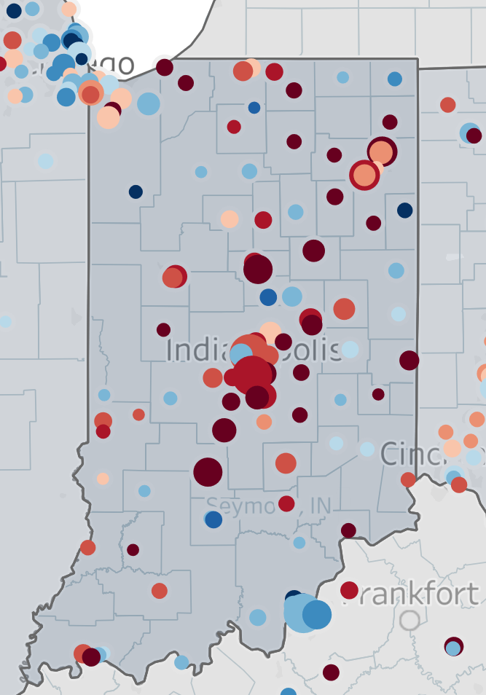
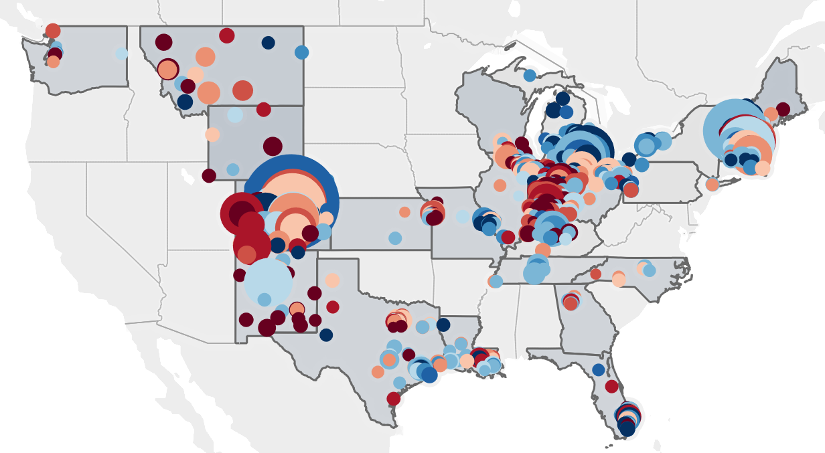
Interactive Map of US Hospital Prices employerptp.org

Slide 17
Supplemental Information, Table 1
RAND 2.0 SUPPLEMENTAL STUDY DATABASE
FREELY AVAILABLE
Hospital name | Hospital Compare Star | Number of Outpt. services | Total Private Allowed Outpt. ($ millions | Simulated Medicare Outpt. | Relative price for Outpt. Services | Stand. price per Outpt. service | Number of Inpt. stays | Total Private Allowed Inpt. ($ millions | Simulated Medicare Inpt. | Relative price for Inpt. services | Stand. price per Inpt. stay | Total Private Inpt. and Outpt. (# millions) | Simulated Inpt. and Outpt. ($ millions) | Relative price for Inpt. and Outpt. services
Parkview Regional Medical Center | 3 | 34863 | 30.1 | 5.8 | 515% | $353.93 | 2401 | 18.1 | 6.5 | 280% | $17,359 | 48.2 | 12.3 | 392%
Eskenazi Health | 4 | 5494 | 1.0 | .3 | 332% | $249.98 | 375 | 2.1 | 1.3 | 157% | $14,679 | 3.1 | 1.6 | 189%
Indiana University Health | 3 | 61214 | 33.5 | 7.0 | 475% | $359.29 | 4431 | 52.8 | 21.1 | 249% | $24,954 | 86.2 | 28.2 | 306%
Source: Derived from Supplement, White, 2019, Prices Paid to Hospitals by Private Health Plans are High Relative to Medicare and Vary Widely-Findings from an Employer-Led Transparency Initiative. Line of service information for inpatient and outpatient services in tables 4 and 5

Slide 18
RAND 2.0 National Hospital Price Study of 25 states
Conducted by RAND, commissioned by Employers’ Forum of Indiana
Services | Hospital inpatient, hospital outpatient
States | CO, FL, GA, IL, IN, KS, KY, LA, MA, ME, MI, MO, MT, NH, NC, NM, NY, OH, PA, TN, TX, VT, WA, WI, WY
Years | 2015-2017
Hospitals | 1598 short-stay general medical/surgical
Allowed amount (2015-7) | $12.9 billion in payments ($6.3 billion inpatient, $6.6 billion outpatient)
Claims (2015-7) | 330,000 claims inpatient, 14.2 million outpatient line items
Data sources | 2 all payer claims databases, many health plans, ~45 self-funded employers
Funders | RWJF, NIHCR, THFI, self-funded employers (not health plans or hospitals)
Source: White, 2019, Prices Paid to Hospitals by Private Health Plans are High Relative to Medicare and Vary Widely-Findings from an Employer-Led Transparency Initiative

Slide 19
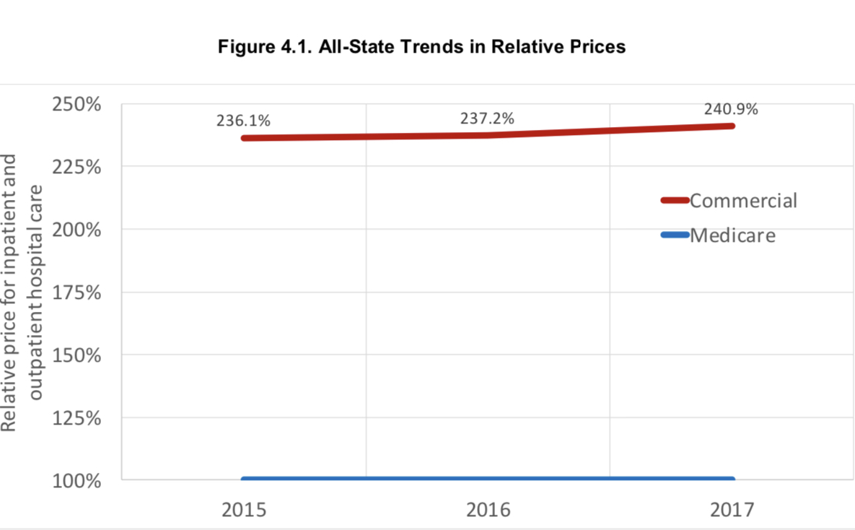
Across 25 States: Employer Health Plans Pay Hospitals 241%
of What Medicare Would Pay and Overall Trend in Increasing
Source: White, 2019, Prices Paid to Hospitals by Private Health Plans are High Relative to Medicare and Vary Widely-Findings from an Employer-Led Transparency Initiative

Slide 20
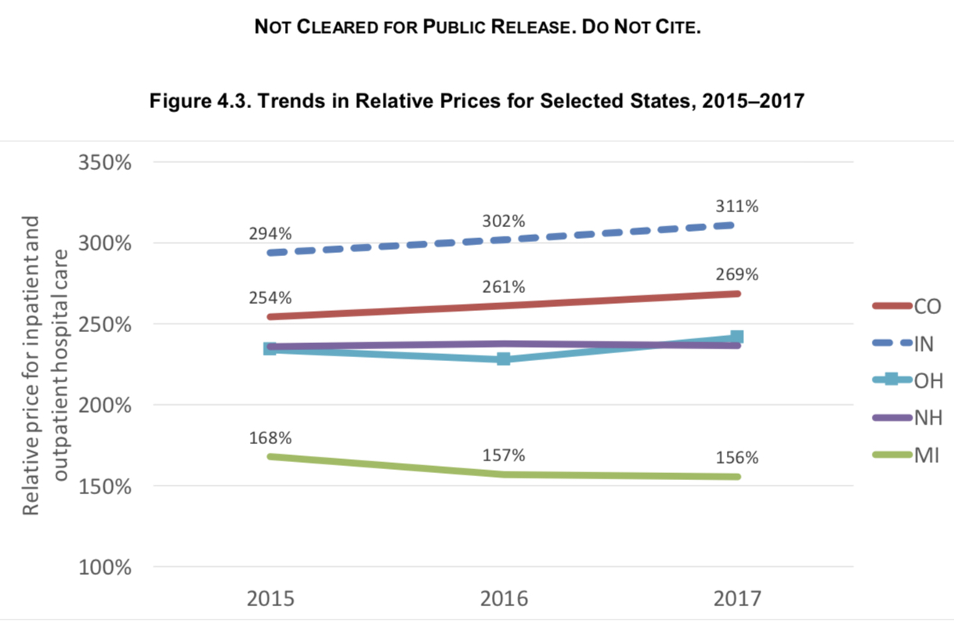
Commercial Relative Price TREND Varies at the State Level:
Comparison of 5 States
Source: White, 2019, Prices Paid to Hospitals by Private Health Plans are High Relative to Medicare and Vary Widely-Findings from an Employer-Led Transparency Initiative

Slide 21
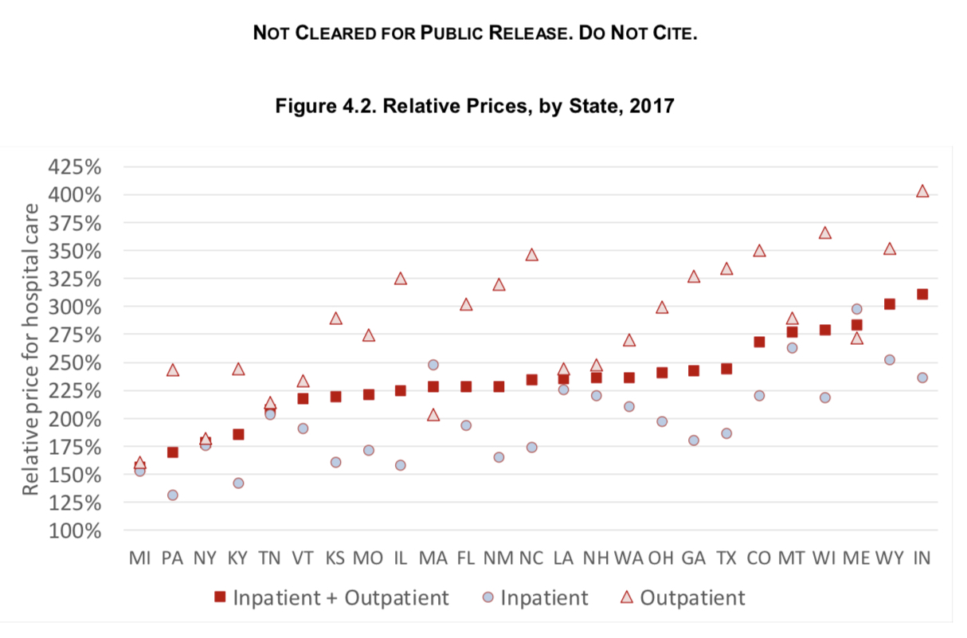
Across 25 States: Average Relative Hospital Prices, 2017
Percent Employer Health Plans Pay Hospitals Relative to What Medicare Would Pay
Source: White, 2019, Prices Paid to Hospitals by Private Health Plans are High Relative to Medicare and Vary Widely-Findings from an Employer-Led Transparency Initiative

Slide 22
Indiana: TOTAL Hospital Commercial Prices Relative to Medicare, 2017
(inpatient plus outpatient)
311%
** RAND 2.0 Study period (2015-2017) averages as study does not provide 2017 relative prices for these two hospitals only
Source: Derived from Supplement, White, 2019, Prices Paid to Hospitals by Private Health Plans are High Relative to Medicare and Vary Widely-Findings from an Employer-Led Transparency Initiative

Slide 23
Indiana: INPATIENT Commercial Prices Relative to Medicare, 2017
236%
** RAND 2.0 Study period (2015-2017) averages as study does not provide 2017 relative prices for these two hospitals only
Source: Derived from Supplement, White, 2019, Prices Paid to Hospitals by Private Health Plans are High Relative to Medicare and Vary Widely-Findings from an Employer-Led Transparency Initiative

Slide 24
Indiana: OUTPATIENT Commercial Prices Relative to Medicare, 2017
403%
** RAND 2.0 Study period (2015-2017) averages as study does not provide 2017 relative prices for these two hospitals only
Source: Derived from Supplement, White, 2019, Prices Paid to Hospitals by Private Health Plans are High Relative to Medicare and Vary Widely-Findings from an Employer-Led Transparency Initiative

Slide 25
Single Health-System: Indiana vs. Michigan
TOTAL Relative Inpatient plus Outpatient Prices 2017
Source: Derived from Supplement, White, 2019, Prices Paid to Hospitals by Private Health Plans are High Relative to Medicare and Vary Widely-Findings from an Employer-Led Transparency Initiative

Slide 26
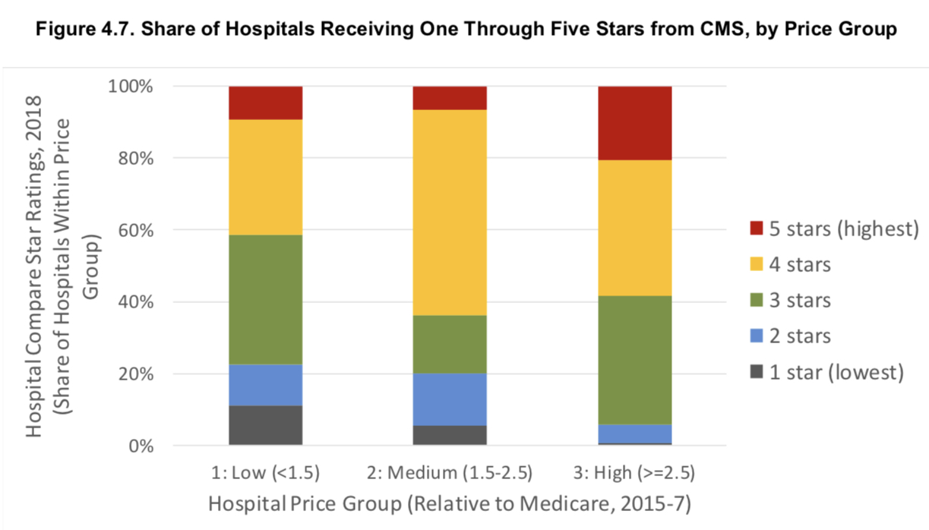
Best Quality Using CMS Hospital Star Ratings and BEST PRICE Using RAND 2.0 Study Findings: Across 25 States
GOAL!
< 150%
150-250%
> 250%
Source: White, 2019, Prices Paid to Hospitals by Private Health Plans are High Relative to Medicare and Vary Widely-Findings from an Employer-Led Transparency Initiative

Slide 27
NEXT STEPS
Benefit Design Levers
can be built on a foundation of contracting
a multiple of Medicare pricing so prices are comparable
Bundled Payments for COEs
Narrow/Tiered networks
Reference based benefits
Direct employer to hospital contracting
Policy Levers
Prohibit gag clause between carriers and hospitals
Prohibit anti-tiering/anti-narrow contract provisions
Limit/cap on out-of-network charges
State Monitoring Org for Quality & Price Transparency

Slide 28
Legislative Round Table: How Do High Health Care Costs Impact Indiana Employers
Limits:
  employee salary wage raises
  hiring the best talent (as need competitive wages and benefit)
  financial reserves (which results in more lay-offs in business slump)
  funds available to invest in business expansion
  health care services offered to retirees
  funds available for community support
Increases:
  Employer and employee out-of-pocket contributions for health care (which limits employee household funds available for other living expenses)

Slide 29
Legislative Policy
Federal Bill: Lower Health Care Cost Act draft released May 23, 2019, Senator Lamar Alexander (R-Tenn)
Lower Health Care Cost Act (165 page bill) but here is terrific 9 page summary:
https://www.help.senate.gov/imo/media/doc/LHCC%20Act%20section%20by%20section%205_23_2019.pdf

Slide 30
Federal Bill: Lower Health Care Cost Act
Covers a wide range of topics, of which 3 sections are noted below:
1. Sec. 301. Increasing transparency by removing gag clauses on price and quality information.
• Bans gag clauses in contracts between providers and health plans that prevent enrollees, plan sponsors, or referring providers from seeing cost and quality data on providers.
• Bans gag clauses in contracts between providers and health insurance plans that prevent plan sponsors from accessing de-identified claims data that could be shared, under HIPAA business associate agreements, with third parties for plan administration and quality improvement purposes.

Slide 31
Federal Bill: Lower Health Care Cost Act continued
Sec. 302. Banning anticompetitive terms in facility and insurance contracts that limit access to higher quality, lower cost care.
• Prevents “anti-tiering” and “anti-steering” clauses in contracts between providers and health plans that restrict the plan from directing or incentivizing patients to use specific providers and facilities with higher quality and lower prices.
• Prevents “all-or-nothing” clauses in contracts between providers and health plans that require health insurance plans to contract with all providers in a particular system or none of them.
• Prevents “most-favored-nation” clauses in contracts between providers and health plans that protect an insurance company’s dominant position in a market by requiring that the insurance company be given the most favorable pricing of any health plan in the market.
• Prohibits obligations on plan sponsors to agree to terms of contracts that the sponsor is not party to and cannot review, which could conceal anti-competitive contracting terms.

Slide 32
Federal Bill: Lower Health Care Cost Act continued
Sec. 303. Designation of a nongovernmental, nonprofit transparency organization to lower Americans’ health care costs.
• Designates a nongovernmental, nonprofit entity to improve the transparency of healthcare costs.
• The nonprofit entity, in compliance with current privacy and security protections, will use deidentified health care claims data from self-insured plans, Medicare, and participating states to help patients, providers, academic researchers, and plan sponsors better understand the cost and quality of care, and facilitate state-led initiatives to lower the cost of care, while prohibiting the disclosure of identifying health data or proprietary financial information.
• Creates an advisory committee composed of public and private sector representatives to advise the entity on the format, scope, and uses of this data, and establish the entity’s research and reporting objectives.
• Creates custom reports for employers and employee organizations seeking to utilize the database to lower health care costs.
• Authorizes grants to states to maintain or create similar transparency initiatives.

Slide 33
RAND 3.0 Enrollment is ongoing Now
…..All Employers across the US are welcome
The more states and the more hospitals per state that participate in RAND 3.0, the more valuable it becomes to employers as it helps inform their local strategy towards paying for value.
Cost to participate in the study, 2 options:
  No charge (free) if wish to contribute claims data to RAND for the PUBLIC report as we will have grant funding to support this work, or
  For employers, who in addition, wish to have a PRIVATE employer-level report, the charge is $0.20 per member (min of $1000, up to a max of $15,000 for jumbo employers, payable to RAND Corp.)

Slide 34
What is New in RAND 3.0?
Adding provider allowed professional fees
Adding allowed facility fees
Wish list with many items:
  percent Medicare and Medicaid per hospital
  CMS Hospital Quality Star Ratings per state
  Hospital Profit Margins per the CMS HCRIS reports that hospitals submit to CMS
  …and more

Slide 35
To Sign up for RAND 3.0, Visit EmployerPTP.org
RAND 3.0
  Sign up form if interest – then Emily Hoch, RAND project manager, will reach out to you. She will send you everything you need to get started.
  FAQ
  DUA
  Cost-Sharing Agreement
RAND 2.0
  Master Slide Deck – use as you wish on your with your own logo for any purpose (including invite slides for RAND 3.0)
  PDF of report
  Excel Database
  Tableau interactive map

Slide 36
RAND 3.0 Study Timeline
Month, Year | Milestone
March, 2019 | Recruitment of self-funded employers, APCDs, and health plans
July-August, 2019 | Agreements in place between RAND and employers, DUAs in place between RAND and health plans/APCDs, and authorizations sent by self-funded employers to their TPAs
September-October, 2019 | Data delivery to RAND complete
November, 2019 | Data testing and analysis
First Quarter, 2020 | Public report finalized and made public online, private employer-level reports distributed

